Slide 1

Introduction
Vector Databases
Notes:
Hello everyone, and good day to all.
Today we are going to talk about vector databases, and about why they have become such an important piece of the Gen AI stack.
Let me start with the problem, because that will make everything else easier to follow. For the last forty years or so, we have built our systems around databases that expect neat data. Rows, columns, fixed schemas. That worked very well as long as the data we cared about looked like a spreadsheet. Customer IDs, order amounts, dates, quantities. All of that fits.
But look at the data any organisation actually produces today. Emails. Support tickets. Contracts. Scanned invoices. Meeting recordings. Product photographs. Chat logs. Almost none of that fits into a table without throwing away most of what makes it useful. And this kind of data is growing much faster than the tidy kind.
So we have a gap. We have huge amounts of information that our traditional databases cannot really search, because searching it properly means understanding what it says, not just what characters it contains.
Vector databases are the answer that the industry converged on. Over the next few sessions we will build up to them step by step.
We will start by looking at what a vector database actually is and how it differs from a relational database. Then we will compare traditional keyword search against vector search, so you can see with your own eyes why one returns better results than the other. After that we will open up the mathematics a little and look at the search metrics, which are the different ways of measuring how similar two pieces of data are. Then we will look at search mechanisms, which is how the database avoids checking every single record when you run a query. And we will close by looking at some of the vector databases you are likely to run into in practice.
Let us begin.

Slide 2

Embeddings: Semantic Meaning -> Concept
Notes:
Remember, Embeddings capture meaning, not spelling. That applies to text, and it applies equally to audio and video once those are converted into embeddings too. Two pieces of content that mean similar things end up as vectors that sit close together in that numerical space, regardless of the exact words or sounds used to express them.
I am going to repeat this point several times across the course, and I am doing that on purpose. Search, similarity metrics, retrieval, all of the topics ahead rest on this one idea holding true. If embeddings did not actually capture meaning, none of what follows would work. All of Gen AI would fall apart.
Quick note on vocabulary. I will use embedding and vector interchangeably for the rest of the course.
Let’s look at an example.

Slide 3
Vector Databases: The Memory Engine for LLMs
Notes:
Traditional databases come in two families. Relational ones like MySQL and PostgreSQL, and NoSQL ones like MongoDB. Both are built for structured data. You define a schema first, and every record follows that shape.
Queries then match on exact values. Show me orders above five thousand. Find this exact email. Fast, because the database knows precisely what to look for.
But, as we already know, Most data today is not structured. Some estimates say eighty percent. Text, images, audio, video, all piling up in a form that does not fit rows and columns.
Vector databases came out of that problem. A vector database stores and queries data as embeddings instead of rows and columns. Rather than storing a sentence and matching its letters, it stores numbers representing what the sentence means, and compares those numbers.
Why now and not twenty years ago? Because AI models became the standard way of processing unstructured data, and their main output is the embedding. Once embeddings became the currency of AI systems, we needed a database built to hold them.
One way to think about it. The vector database is the memory engine for a large language model.
An LLM reasons well out of the box. But it has no long term memory and no access to your private data. It knows its training set and nothing more.
The vector database fills both gaps. It holds your documents and policies as embeddings. When someone asks a question, the system pulls the relevant pieces and hands them to the model with the question. The model answers from your data instead of guessing.
That gives context it never had in training, and it cuts hallucination sharply. This pattern is called Retrieval Augmented Generation, or RAG, and we will cover it later.

Slide 4
Text
Audio
Embedding Models
Vector Databases
Image
Processed Data
Embeddings
Video
Unstructured Data
Notes:
We start with unstructured data. Structured data has a predefined format, like an Excel sheet where every column has a name and a type. Unstructured data does not. It is text inside a PDF, a Word file, a web page, a JSON file. Plenty of content, but nothing telling you what it means.
Next it gets processed. We pull the text out of the file format, clean it, and split it into sensible pieces. Nothing clever yet.
Then the embedding model, which is the heart of this. Think of it as a translator. It takes processed data and returns an embedding, a list of numbers, often several hundred of them.
What matters is what those numbers mean. They capture meaning, not spelling. Similar meanings sit close together, different meanings sit far apart.
Now you need somewhere to put these embeddings, and you need to search them quickly. A million embeddings are useless if the search takes ten minutes.
That is the last box, the vector database. It stores the embeddings, and sometimes even keeps a link to the original content.
On a tangential note, I strongly believe the name “Vector Databases” should be called “Embeddings Databases”. But, since embeddings are also called vectors in some circles, the creators used Vector Databases. In case I say vectors, think embeddings.

Slide 5
The Search for Similar
Vector Databases
Notes:
Hello everyone and Good day to all.
So far we have talked about embeddings and how they get created and stored. Now let's turn to what actually makes vector databases useful, which is search.
To really see why vector search matters, it helps to place it side by side with the search method most of us already know, traditional keyword search. Once you watch both methods handle the exact same query, the difference becomes obvious rather than theoretical.
Again, remember, Embeddings have the capability to represent meaning.

Slide 6
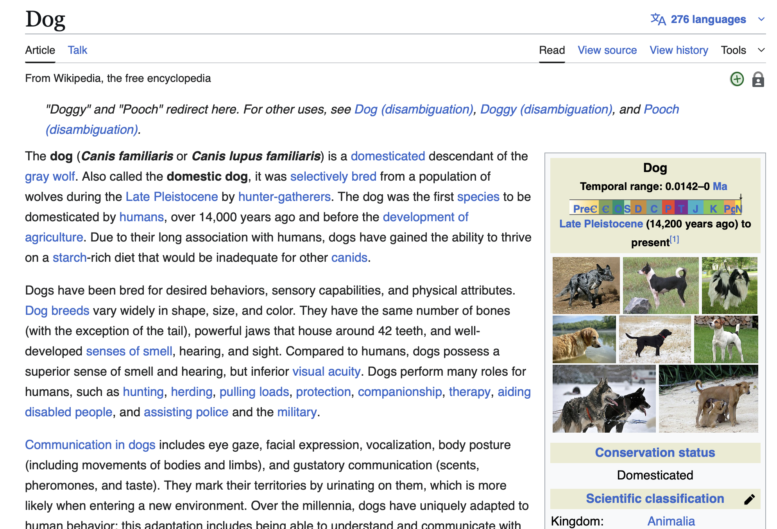
Traditional Search
Keyword: Dog
Lexical Matches
Notes:
Let's start with traditional search, since most of you already have some intuition for it.
Traditional search works by matching keywords, which is why it is also called lexical search. It operates on the literal words rather than on meaning. When you type the word dog, the system does not try to understand what a dog is. It scans its index for documents containing that exact string of letters, d-o-g. The most common algorithm behind this kind of search is called BM25, and it still powers a lot of search systems in use today.
Look at what happens here. We search for dog, and the system correctly returns the Wikipedia article titled Dog. That part works fine.
Here is the limitation, though. The system has no deeper understanding of the concept. It does not know that a poodle is a dog, or that a beagle is a dog. All it knows is the sequence of characters you typed. If an article talks about a golden retriever and never uses the word dog, traditional search will not find it, even though anyone reading that article would immediately recognize it as being about a dog. Keyword search is blind to any content that expresses the same idea using different words.

Slide 7
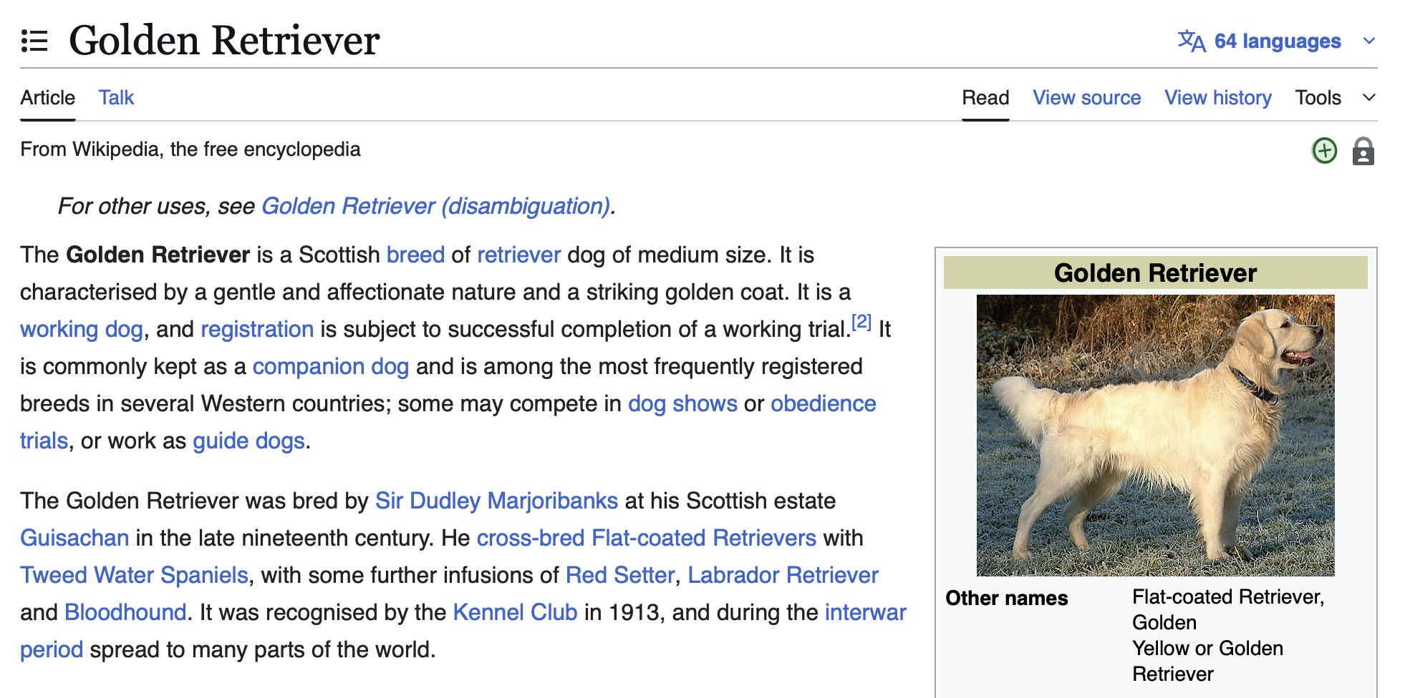
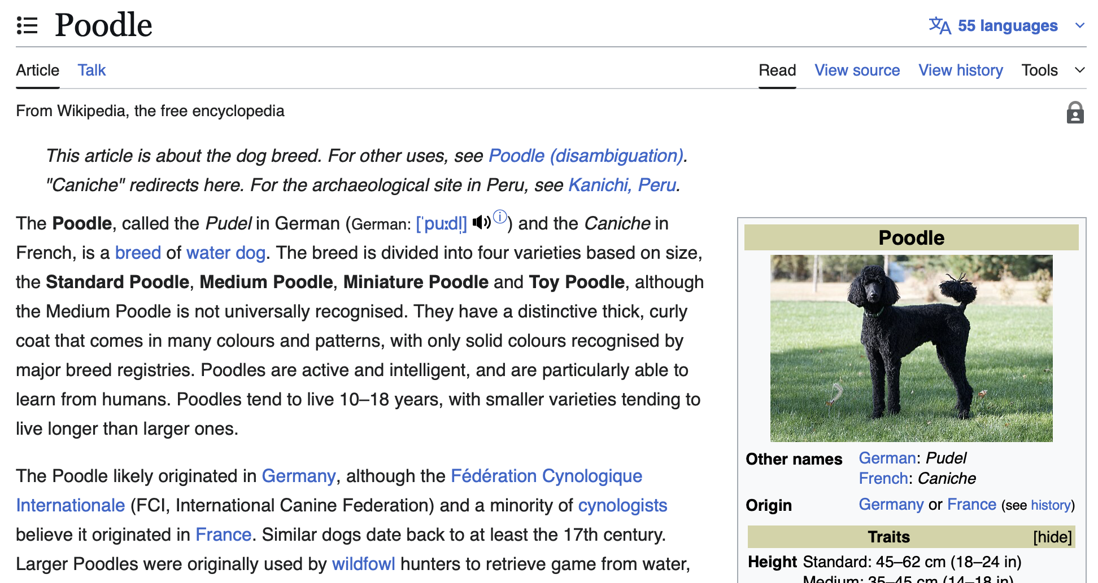
Vector Search
Keyword: Dog
Semantic Matches
Notes:
Now let's run the same query, dog, through vector search instead.
Vector search does not look at the letters in your query at all. It uses the embedding pipeline we covered earlier. Your query gets converted into a numerical vector that represents its meaning, the same way any other piece of text would be. The system then searches the database for embeddings that are mathematically close to that query vector.
Look at the results. The search still returns the main Dog article, just like before. But now it also returns articles on Golden Retriever and Poodle, as well. The system recognizes that these are all instances of the same underlying concept, so their embeddings sit close together in the vector space.
This is the payoff of everything we said about embeddings capturing meaning. The results here are more complete and more relevant, because the search understands how ideas relate to each other, not just how they happen to be spelled.

Slide 8
Traditional Search: Keywords
Semantic Search: Concepts
Notes:
In simple terms:
Traditional search finds documents that contain the word you typed. That makes it fast and simple, but it also makes it brittle. It is highly sensitive to exact spelling and exact phrasing, and a small change in wording can cause it to miss a perfectly relevant document.
Vector search finds documents that are about the concept you are asking for. It does not care how that concept happens to be phrased. This is what lets real applications understand intent, handle synonyms, work across different languages, and even connect an image to a piece of text describing the same thing.

Slide 9
High-Level Vector Search System
Embedding Model
Vector Database
Large Unstructured Data
Embeddings
Similarity Search
Same Embedding Model
Search Query
Query Embeddings
Results
Notes:
Now let's put the whole system together and trace the architecture end to end. This high-level diagram shows what a real vector search system looks like once it is running in production.
There are two separate paths here, so let's walk through each one in order.
The first path happens once, ahead of time, and it is called ingestion. Large unstructured data goes into an embedding model, the embedding model converts it into vectors, and those vectors get stored in the vector database. This usually happens in bulk, well before anyone ever runs a search.
The second path happens every single time a user runs a query. A user types a search query, which is just another piece of text. That query passes through the same embedding model used during ingestion, and comes out as a query embedding.
Pay close attention to the word same there, because it matters more than it looks. The query has to go through the identical embedding model that produced the stored embeddings. Use a different model, and the resulting vectors live in a different numerical space entirely, so comparing them tells you nothing, the same way comparing a distance measured in miles against one measured in kilometers gives you a meaningless number unless you convert first.
Once the query embedding exists, the system runs a similarity search, comparing that query vector against everything stored in the database, and returns the closest matches as results.
This pattern, embed once during ingestion, embed again at query time with the same model, then compare, is the foundation under a lot of modern AI applications. It powers smarter search engines, question answering chatbots, and a technique we will study properly later called Retrieval Augmented Generation, or RAG, which is how language models get access to specific, current information they were never trained on.

Slide 10
This reveals an elegant piece of logic
If two embeddings are similar, their original sentences are guaranteed to share a similar meaning.
Vector database will contain only answer-based sentences (which are stored as embeddings).
If query embedding is similar to one of the embeddings in the vector database, then the two sentences are similar.
But, one is a question and the other is an answer.
Notes:
This reveals an elegant piece of logic.
If two embeddings are similar, the original sentences behind them are guaranteed to share a similar meaning.
Now picture a vector database that stores only answers. Just statements of fact, the kind of sentences you would want a chatbot to hand back to a user.
A user comes along and asks a question. That question gets embedded, the same way everything else in this pipeline gets embedded. And suppose that question's embedding turns out to be similar to one of the answer embeddings already sitting in the database.
Remember, similar embeddings mean similar sentences. So the logic says these two sentences are similar.
But, One is a question. The other is an answer. They are not similar in the way two paraphrased statements are similar. One asks something, the other tells you something.
And that is the elegant part. A well-trained embedding model does not only place paraphrases of the same sentence near each other. It also learns to place a question near the answer that resolves it, because the two are strongly related, even though they are different kinds of sentences. Closeness in the vector space turns out to mean something broader than just meaning the same thing. It can also mean belonging together.
That is exactly the mechanism that lets a system take a user's question and pull out the right stored answer, even though nothing in the database was ever phrased as a question at all.

Slide 11
Search Metrics
Vector Databases
Notes:
Hello everyone and Good day to all.
We have spent the last few sessions talking about vector search at a conceptual level, comparing it to keyword search and seeing why it wins. Now let's go one level deeper and ask a very practical question. When the system says two embeddings are similar, what is it actually measuring? How does it put a number on similarity?
That number comes from something called a search metric. Before we go further, again a small note on vocabulary. You will also hear these called similarity metrics or distance metrics. All three terms point to the same thing, a formula that takes two vectors OR embeddings and returns a number telling you how close or how far apart they are.
Another tangential note, embeddings are generally a long list of numbers: sometimes 300 numbers, 768 numbers or even more. These are called embedding dimensions.
But, we are going to showcase embeddings as list of 2 numbers just for visualization and ease of understanding purposes.

Slide 12
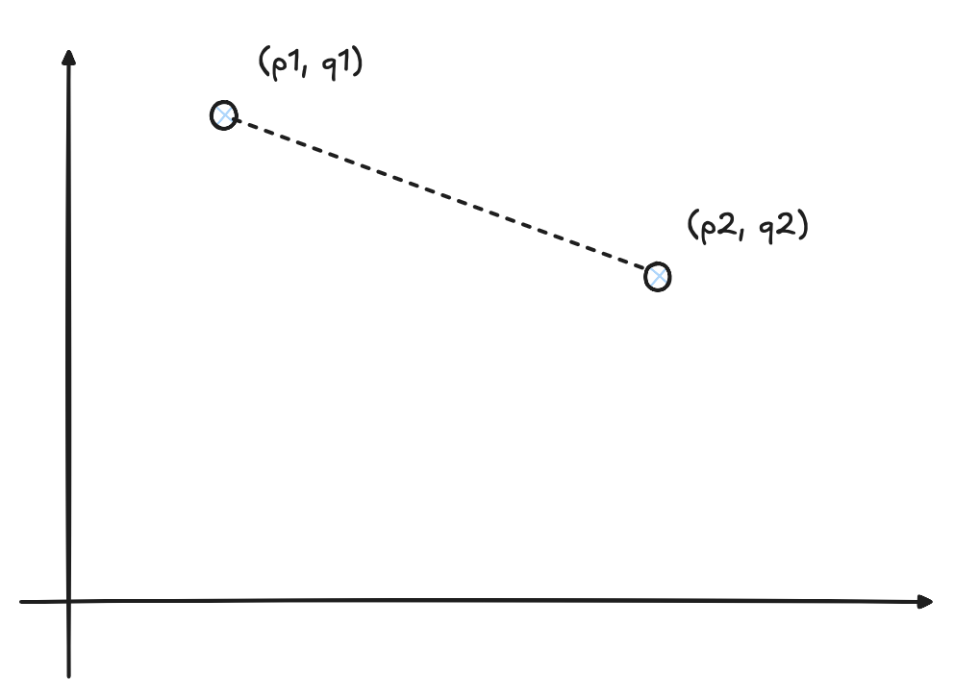
Euclidean Distance
Shortest straight line between two vectors.
Closer the points, more similar the raw data.
Notes:
Let's start with the one that matches your everyday intuition about distance, Euclidean distance.
Picture two points on a map, and imagine you have a ruler. Euclidean distance is just the length of the straight line you would draw connecting those two points. That is the whole idea. It works exactly the same way in the high-dimensional space where our embeddings live, except instead of two dimensions like a map, we might have a few hundred or a few thousand.
So what does this number tell us? A smaller Euclidean distance means the two embeddings are close together, which means the original sentences behind them share a similar meaning. A larger distance means they are far apart, which means the sentences mean different things.
One useful thing to remember about this metric is its range. Euclidean distance can be anywhere from zero upward, with no upper limit. Zero means the two vectors are identical. There is no fixed ceiling on how far apart two vectors can get.

Slide 13
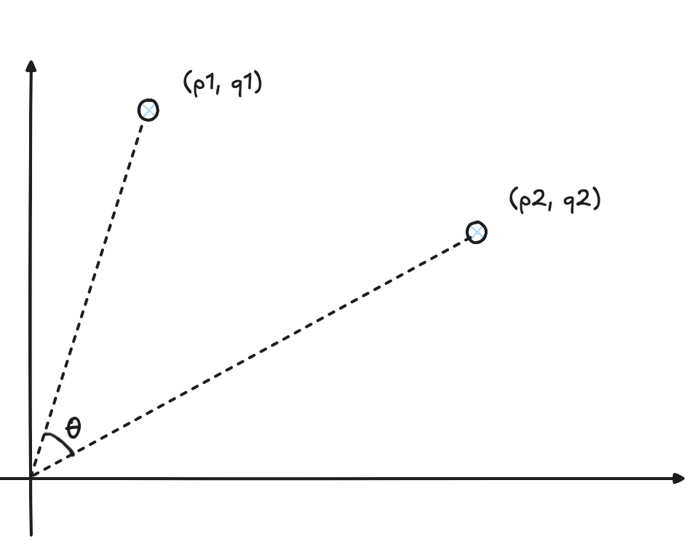
Cosine Similarity
Angle between two vectors.
Smaller the value of θ, more similar the raw data.
Notes:
Now let's look at a different way of measuring similarity, one that ignores distance entirely and looks only at direction. This is cosine similarity.
Instead of asking how far apart two vectors are, cosine similarity asks what angle sits between them. Picture two arrows starting from the same point. If they point in exactly the same direction, it does not matter how long each arrow is, cosine similarity will call them highly similar. Length, or magnitude, is ignored completely. Only direction counts.
This gives cosine similarity a clean, fixed range, from minus one to plus one, and each end of that range has a clear meaning.
A value of one means the two vectors point in exactly the same direction, a zero degree angle between them. That is perfect similarity.
A value of zero means the vectors sit at a ninety degree angle to each other. They are called orthogonal, and it means there is no similarity between them at all.
A value of minus one means the vectors point in completely opposite directions, a hundred and eighty degree angle. That is perfect dissimilarity.

Slide 14
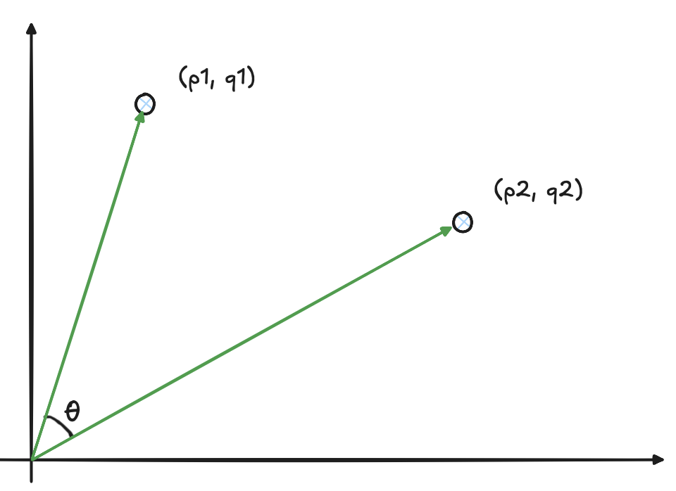
Dot Product
Angle and Magnitude between two vectors.
Greater the value of the dot product, more similar the raw data.
Notes:
Now let's look at a third metric, the dot product, and to understand it, we need to shift our geometric picture slightly.
With cosine similarity, we only cared about the angle between two vectors. With the dot product, we bring back something we set aside, magnitude. Picture the same two arrows from before, starting at a common origin point, with an angle theta between them. This time, we care about both that angle and how long each arrow is.
So the dot product measures two things at once, how aligned the vectors are in direction, and how large they are. Because of that, it is often described as a measure of correlation rather than pure direction or pure distance.
Here is how to read the result. A large positive dot product means the vectors point in a similar direction and both have large magnitude, and that tells us the original sentences are similar. A large negative value means the vectors point in opposite directions with large magnitude, telling us the sentences are highly dissimilar. And when the embeddings are normalized, meaning their magnitudes are scaled to a standard length, the dot product ends up ranging from minus one to plus one, the same range as cosine similarity.

Slide 15
When to use which similarity metric?
Metric Type | Common Use Cases
Euclidean Distance
Cosine Similarity
Dot Product
Image Recognition, Similarity & Search
Text Similarity & Search, Chatbots
Recommendation Systems
Notes:
We now have three metrics on the table, Euclidean distance, cosine similarity, and dot product. The natural question is, which one should you actually use?
The honest answer is that it depends entirely on your data and on what similarity is supposed to mean for your specific problem. Let's go through the three common cases shown here.
Start with image recognition and image search. Here, Euclidean distance tends to work best. When an image becomes a vector, each dimension can represent something like a pixel's color or some other visual feature. Two images that look alike, similar colors, similar object placement, end up with vectors that sit close together in that space. Euclidean distance captures that closeness directly, which is exactly what you want when comparing images.
Next, text similarity and search, along with chatbots. Here, cosine similarity is usually the better fit. Suppose you have a short sentence and a long article, both about machine learning. You want the system to recognize that they are about the same topic, even though one is far longer than the other. Cosine similarity is built for exactly this, because it ignores magnitude entirely and looks only at direction, meaning it is not thrown off by how long a document is. It only cares whether the two pieces of text are pointing at the same topic.
Finally, recommendation systems. Here, the dot product tends to win, because it combines both of the things the other two metrics look at separately, direction and magnitude. A high dot product score tells you two things at once, that there is a strong match in interest, which comes from a small angle between the vectors, and that there is a high level of engagement or popularity, which comes from large magnitude. That combination of relevance and popularity is exactly what you want when ranking recommendations for a user.
So the pattern to remember is this. Ask what your data is and what similarity should mean for your use case, and that answer will usually point you straight at the right metric.

Slide 16
Search Mechanisms
Vector Databases
Notes:
We now know how to measure similarity between two vectors, using Euclidean distance, cosine similarity, or dot product. But knowing how to compare two vectors is only half the problem.
Here is the real question. What if your vector database holds one hundred million embeddings? When a query comes in, do you compare that query against all one hundred million of them, one at a time? The honest answer is no. That would work, but it would be far too slow to use in any real application.
So we need something smarter than checking everything. That is what search mechanisms give us, a strategy for applying the similarity metrics we just learned in a way that scales.

Slide 17
Exact Neighbour Search
Exhaustive, accurate search.
Notes:
Let's start with the simplest approach possible, Exact Nearest Neighbor search, often shortened to ENN. You will also hear this called k-Nearest Neighbors, or k-NN.
The idea here is about as straightforward as it gets. To find the closest matches to a query, you compare that query against every single embedding stored in the database. For each one, you calculate a similarity score, using something like Euclidean distance or cosine similarity, and then you rank everything and return the top results.
Because it checks every single record with no shortcuts, this approach guarantees that you get the actual closest points to your query. There is no approximation here. If the true nearest neighbor exists in your database, ENN will find it, every time.
The catch, as you'd expect, is speed. Checking every single embedding for every single query is exhaustive work, and it gets slower as your database grows. That trade-off is exactly what the next few slides are about.

Slide 18
When to use which search mechanism?
3S: Speed, Scale and Specificity (accuracy)
Search Mechanism | Pros | Cons | When to Use | Use Cases
Exact Neighbour Search | Perfectly accurate; Simple to understand. | Extremely Slow | Choose when accuracy is paramount, and application does not need real-time results | Scientific research, medical diagnostics, small-scale academic projects.
Notes:
Let's start building a comparison table, and we will use three criteria, shown here as Speed, Scale, and Specificity, which really just means accuracy.
Right now, we only have ENN on the table, so let's place it against these three criteria.
On speed, ENN is slow. That follows directly from what we just covered, it checks every single embedding, so there is no way around the exhaustive work.
On scale, ENN suits small to medium sized datasets. Once your database grows into the millions or hundreds of millions of vectors, checking everything for every query becomes impractical.
On specificity, ENN is exact. It is one hundred percent accurate, because it never guesses. It genuinely finds the true closest match every time.
So ENN gives you perfect accuracy, at the cost of speed and scale. Keep that trade-off in mind, because the next mechanism exists specifically to fix it.

Slide 19
Approximate Nearest Neighbor Search
Fast, group-based search.
Notes:
If ENN is slow because it is thorough, the natural next idea is to trade away some of that thoroughness for speed. That is exactly what Approximate Nearest Neighbor search, or ANN, does.
ANN does not promise the absolute closest match to your query. Instead, it looks for a match that is very close, close enough to be useful, without guaranteeing it is the single best one. While ENN searches exhaustively, ANN settles for close enough, using shortcuts and smart data structures to search efficiently.
How does it actually avoid checking everything? Instead of a brute force comparison, ANN uses indexing methods, things like graphs, trees, or hashing techniques, that organize similar embeddings together ahead of time. When a query comes in, the search only needs to check a small, relevant portion of the dataset, rather than all of it. That is what makes ANN so much faster than ENN at scale.

Slide 20
When to use which search mechanism?
3S: Speed, Scale and Specificity (accuracy)
Search Mechanism | Pros | Cons | When to Use | Use Cases
Exact Neighbour Search | Perfectly accurate; Simple to understand. | Extremely slow | Choose when accuracy is paramount, and application does not need real-time results | Scientific research, medical diagnostics, small-scale academic projects.
Approximate Neighbour Search | Extremely fast and scalable | Slight accuracy loss | Choose when closest relevant results work, or application may have real-time requirements | Chatbots, Image search, recommendation engines, semantic search, anomaly detection
Notes:
Let's add ANN to our comparison table now, right alongside ENN, so we can see the trade-off directly.
On speed, ANN is fast, which is the entire point of the shortcuts and indexing structures we just discussed.
On scale, ANN handles large to massive datasets comfortably, which is exactly where ENN starts to struggle.
On specificity, ANN is approximate. It may miss the true nearest neighbor now and then, since it is not doing an exhaustive search.
So look at what happened across these two rows. ENN gives you perfect accuracy but does not scale. ANN gives you speed and scale, in exchange for giving up the guarantee of perfect accuracy. Neither one is simply better than the other, it depends on what your application actually needs. If you are running a small internal tool with a few thousand records, ENN's perfect accuracy might be worth the slower speed. If you are running search across hundreds of millions of records for live users, ANN's speed is usually the only realistic option.

Slide 21
Hybrid Search
Combine keyword & vector search results.
Notes:
So far we have treated keyword search and vector search as two separate methods, in competition with each other. Hybrid Search takes a different approach, it combines them.
Hybrid Search runs both a keyword based, or lexical, search and a vector based, or semantic, search, and then combines their results. The reasoning behind this is simple. No single search method is perfect for every kind of query. Some queries are best served by an exact keyword match, think of someone searching for a specific product code or an exact name. Other queries are best served by understanding meaning, think of someone describing what they want in their own words. Rather than picking one method and living with its blind spots, Hybrid Search uses both and blends the results together.

Slide 22
When to use which search mechanism?
3S: Speed, Scale and Specificity (accuracy)
Search Mechanism | Pros | Cons | When to Use | Use Cases
Exact Neighbour Search | Perfectly accurate; Simple to understand. | Extremely slow | Choose when accuracy is paramount, and application does not need real-time results | Scientific research, medical diagnostics, small-scale academic projects.
Approximate Neighbour Search | Extremely fast and scalable | Slight accuracy loss | Choose when closest relevant results work, or application may have real-time requirements | Image search, recommendation engines, semantic search, anomaly detection
Hybrid Search | Enhanced accuracy and relevance; Handles a wider range of queries | Increased complexity; Higher computational and resource costs | Choose when user intent is complex and can benefit from both keyword precision and semantic understanding. | Modern search engines, QnA chatbots
Notes:
Now let's complete the table by adding Hybrid Search as the third row.
On speed, Hybrid Search sits in the middle, it is moderate. That makes sense, since it is doing two searches and then combining them, so it is not as fast as ANN alone, but it is not doing an exhaustive ENN-style search either.
On scale, Hybrid Search works well for large datasets, similar to ANN.
On specificity, Hybrid Search offers high relevance, because it combines the precision of keyword matching with the conceptual understanding of semantic search. It is not chasing perfect mathematical accuracy the way ENN does, it is chasing relevance from the user's point of view, which is often what actually matters in a real application.
So here is the full picture across all three mechanisms. ENN gives you exactness at the cost of speed and scale. ANN gives you speed and scale at the cost of exactness. Hybrid Search sits in between on speed and scale, but adds something the other two do not have on their own, the ability to catch both exact keyword matches and conceptual matches in the same search. Which one you choose comes down to your specific application, how big your dataset is, how fast you need answers, and how much precision your users actually require.

Slide 23
Popular Vector DBs
Vector Databases
Notes:
Hello everyone and Good day to all.
Let's look at some of the popular vector databases you're likely to run into. We'll go through Milvus, PGVector, Pinecone, Chroma, and Qdrant, one at a time, so you get a feel for how each one is different.

Slide 24
Milvus DB
Open Source
Introduced in 2019
High Performance
Use GPU and other hardware to support trillion-vector datasets
Advanced Indexing
Offers multiple powerful indexing approaches
Scalability & Elasticity
Separates storage and compute allowing for segregated scaling
Unified API
Intuitive code for multiple languages along with a RESTful API.
Hybrid Search
Native hybrid search features available
Notes:
Milvus was introduced in 2019, and it is open source, so anyone can inspect the code or self-host it.
Its biggest strength is performance at scale. It can use GPUs and other specialized hardware, which lets it support datasets running into trillions of vectors. On top of that, it supports multiple indexing approaches, so you can pick the method that fits your data best, rather than being locked into one.
Milvus also separates storage from compute, which means you can scale each one independently. If you need more searching power but your data size hasn't grown, you can scale compute alone, without paying for storage you don't need.
It offers a unified API with clean, intuitive client code across multiple programming languages, plus a RESTful API for straightforward integration. And it comes with native hybrid search built in, so you get keyword and vector search working together without bolting on a separate system.

Slide 25
PGVector
Open Source Extension
Introduced in 2021 for PostgreSQL
Simplicity and Convenience
No need to learn another database; just use PostgreSQL
Cost-Effective
Eliminates needs of multiple database setups
Limited Scalability
Not designed for massive, distributed scale
Fewer Advanced Features
Lacks hardware optimisation, index fine-tuning, etc
ACID Compliant
Transactaction datasets fit naturally
Notes:
PGVector took a very different approach. Instead of building a new database from scratch, it was introduced in 2021 as an open source extension for PostgreSQL, one of the most widely used relational databases in the world.
That choice is exactly where its main advantage comes from. If your team already runs PostgreSQL, you don't need to learn a new database or manage a separate system. You add the extension and start storing vectors right alongside your regular tables. That's a real cost advantage too, since you're not paying to run and maintain a whole separate vector database.
The trade-off is scale. PGVector was not built for massive, distributed workloads the way a purpose-built vector database was. It also has fewer advanced features, it lacks the kind of hardware optimization and fine-grained index tuning you'd get from a system designed around vectors from day one.
Where PGVector does shine is when your data is naturally transactional, meaning it fits well alongside typical database records. It's ACID compliant, so you get the same strong consistency guarantees PostgreSQL is known for, now extended to your vector data too.

Slide 26
PineCone
Fully Managed
Setup, maintenance, scaling, or infrastructure management handled
High Performance and Low Latency
Optimized for real-time search with low query latency, even at scale
Ease of Use
Extremely simple; Managed model reduces operational overhead
Hybrid Search
Native hybrid search features available
Scalability
Designed to scale seamlessly without performance degradation
Serverless Experience
Users only need to worry about their data and queries, not the underlying servers.
Notes:
Pinecone's whole pitch is simple, it is fully managed. Setup, maintenance, scaling, all of the infrastructure work, is handled for you.
It's built for high performance and low latency, optimized specifically for real-time search, even as your dataset grows. Combine that with how simple it is to use. Since the operational overhead is managed for you, your team spends its time on your application, not on keeping a database running.
Pinecone also has native hybrid search built in, and it's designed to scale seamlessly without any drop in performance as your data grows.
Perhaps the clearest way to describe it is a serverless experience. You worry about your data and your queries. Pinecone worries about the servers underneath.

Slide 27
Chroma
Open Source
Released in 2022
Developer-First API
Intuitive Python API that is easy to learn and integrate
Native Embeddings
Includes built-in support for embedding functions from OpenAI, Cohere, and Hugging Face
Flexible Deployment
Can be run in-memory (e.g., in a Jupyter notebook), as a persistent database on a single machine, or in a client/server mode
Analysis and Visualization
Provides utilities to help developers understand and analyze their embeddings
Great Integrations
Deeply integrated with popular LLM framework like LangChain
Notes:
Chroma was released in 2022, and it is open source.
Its standout feature is a developer-first API, an intuitive Python interface that is genuinely easy to pick up and integrate into a project, especially if you're already comfortable in Python. It also comes with native embeddings support built in, meaning it has built-in integrations with embedding providers like OpenAI, Cohere, and Hugging Face, so you don't have to wire that up yourself.
Chroma is flexible about deployment too. You can run it in-memory, say inside a Jupyter notebook while you're experimenting, as a persistent database on a single machine, or in a full client-server setup for production.
It also gives you tools for analysis and visualization, so you can actually look at and understand your embeddings rather than treating them as an invisible black box. And it integrates deeply with popular LLM frameworks like LangChain, which matters if that's already part of your stack.

Slide 28
Qdrant
Open Source
Written in Rust for maximum speed and efficiency
Advanced Filtering
Complex queries can be written easily
Payload Storage
Stores not just the vectors but also associated JSON payloads (metadata), which can be filtered upon
On-Disk Storage
Designed with on-disk storage in mind, allowing it to handle datasets larger than the available RAM
Quantization
Provides utilities to help developers understand and analyze their embeddings
Flexible Deployment
Available as open-source, a Docker image, and a managed cloud solution
Notes:
Qdrant is written in Rust, which is a big part of why it's known for speed and efficiency, and it's open source.
One of its strengths is advanced filtering, it lets you write complex queries easily. This ties into its payload storage feature, Qdrant stores not just the vector itself but also the associated metadata, structured as JSON, and lets you filter directly on that metadata alongside your similarity search. That combination is powerful, you can ask for the closest matches and narrow them down by specific fields at the same time.
Qdrant is also built with on-disk storage in mind, which means it can handle datasets larger than your available RAM, rather than requiring everything to fit in memory at once.
Its quantization feature is about compressing vectors to take up less memory and search faster, by representing them with lower precision instead of full floating-point numbers. This trades a small amount of accuracy for a real gain in speed and storage efficiency, which matters a lot once you're working with very large datasets.
Finally, Qdrant offers flexible deployment. You can run it as open source software yourself, pull a Docker image, or use a fully managed cloud version, depending on how much infrastructure work you want to take on.

